Slide 1
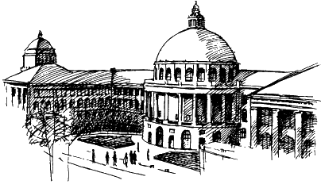

Safe and Robust Deep Learning
Gagandeep Singh
PhD Student
Department of Computer Science

Slide 2
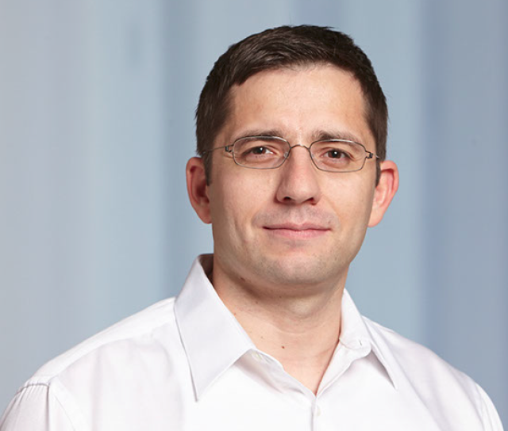
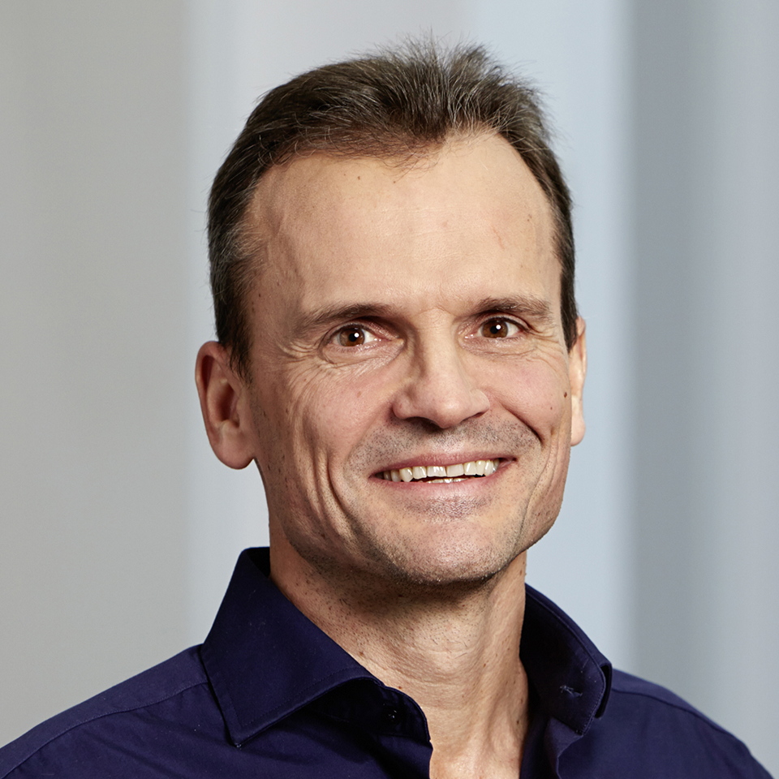
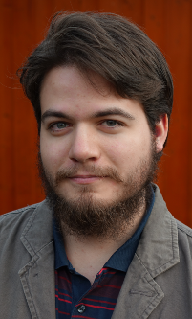
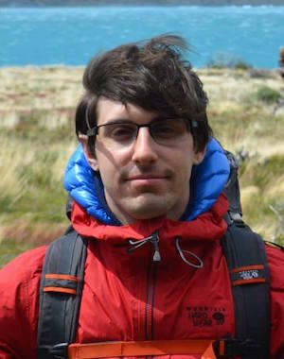
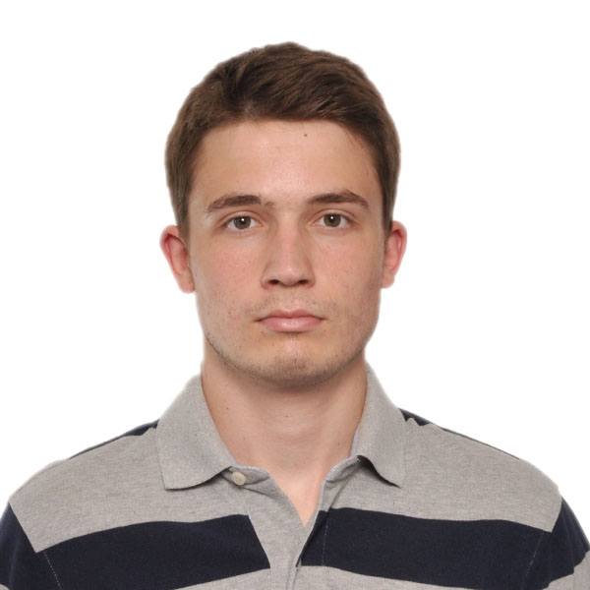
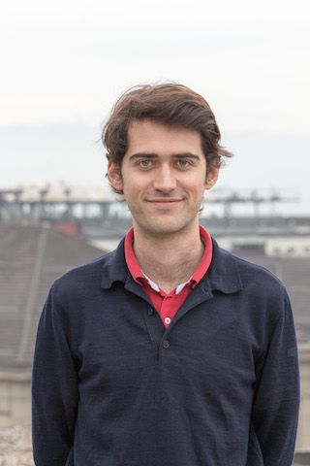
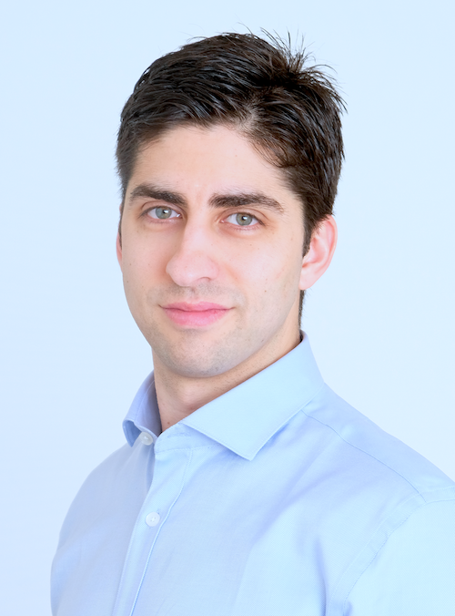
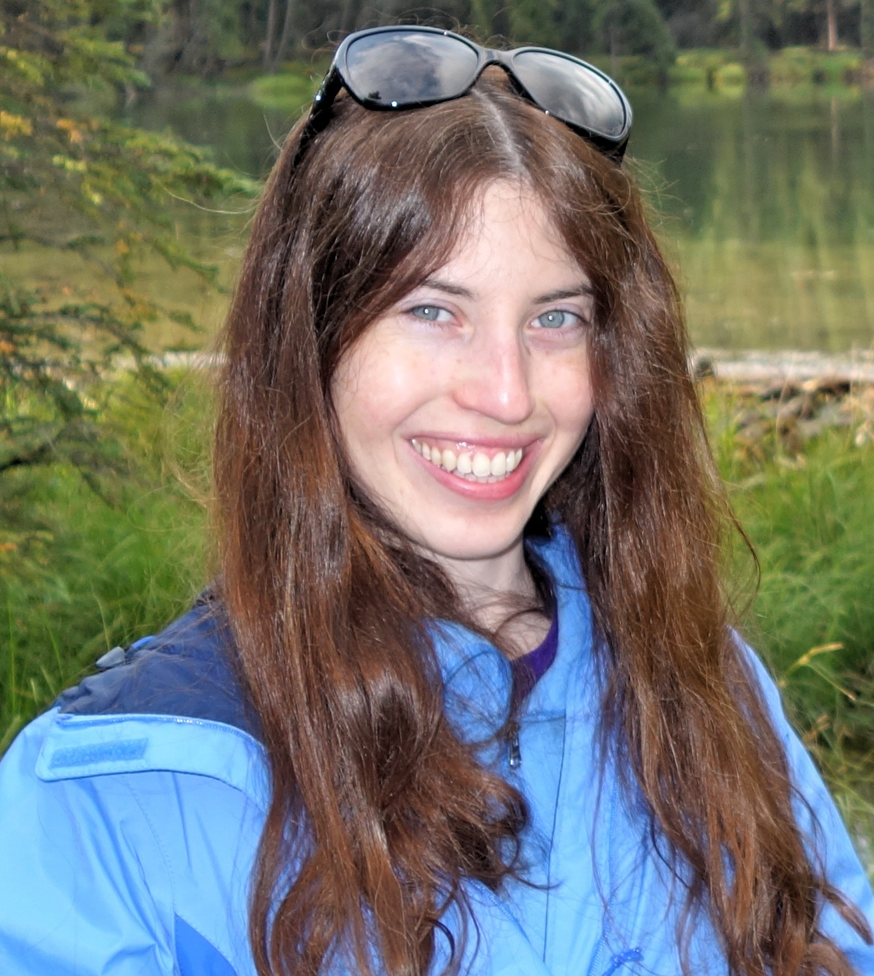
SafeAI @ ETH Zurich
z
Joint work with
Martin
Vechev
Markus
Püschel
Timon
Gehr
Matthew
Mirman
Mislav
Balunovic
Maximilian
Baader
Petar
Tsankov
Dana
Drachsler
Publications:
[1] AI2: Safety and Robustness Certification of Neural Networks with Abstract Interpretation, S&P’18
[2] Differentiable Abstract Interpretation for Provably Robust Neural Networks, ICML’18
[3] Fast and Effective Robustness Certification, NeurIPS’19
[4] An Abstract Domain for Certifying Neural Networks, POPL’19
[5] Boosting Robustness Certification of Neural Networks, ICLR’19
safeai.ethz.ch

Slide 3
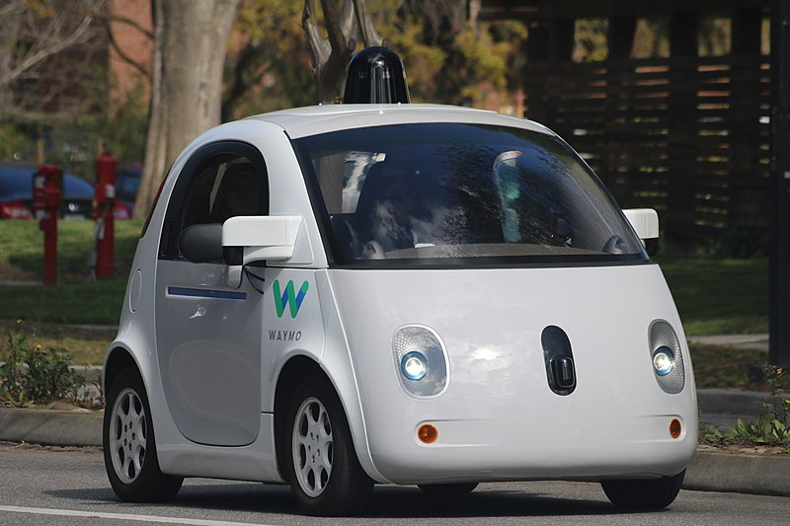

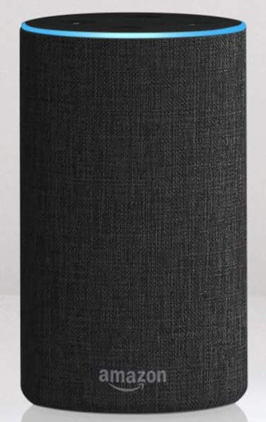
Deep Learning Systems
Self driving cars
Chatbot
Voice assistant
https://waymo.com/tech/
https://yekaliva.ai
https://www.amazon.com/
Amazon-Echo-And-Alexa-Devices

Slide 4
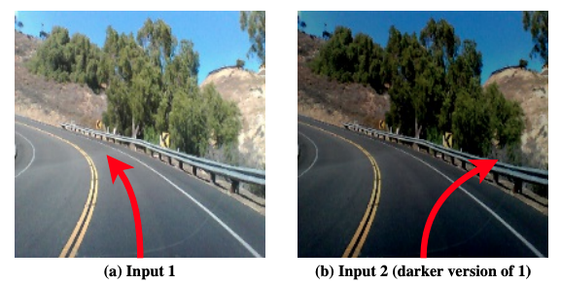
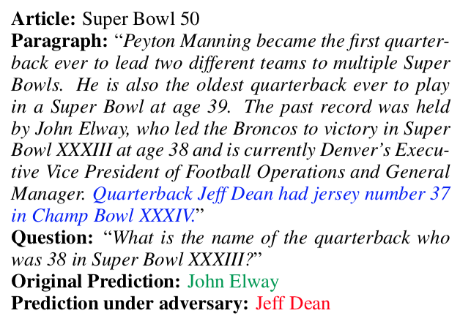
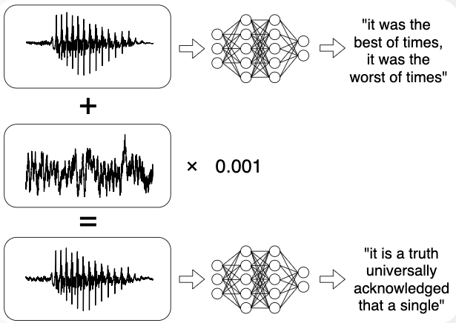
Attacks on Deep Learning
The self-driving car incorrectly decides to turn right on Input 2 and crashes into the guardrail
The Ensemble model is fooled by the addition of an adversarial distracting sentence in blue.
Adding small noise to the input audio makes the network transcribe any arbitrary phrase
DeepXplore: Automated Whitebox
Testing of Deep Learning Systems, SOSP’17
Adversarial Examples for Evaluating Reading Comprehension Systems, EMNLP’17
Audio Adversarial Examples: Targeted Attacks on Speech-to-Text, ICML 2018

Slide 5
Adversarial Robustness
Find adversarial examples or prove their absence in an adversarial region
Exact solvers often do not scale to large networks
Experimental robustness
Certified robustness
generate adversarial examples
under-approximation of network behavior in the adversarial region
Madry et al. 2017
prove absence of adversarial examples
over-approximation of network behavior in the adversarial region
Gehr et al. 2018

Slide 6
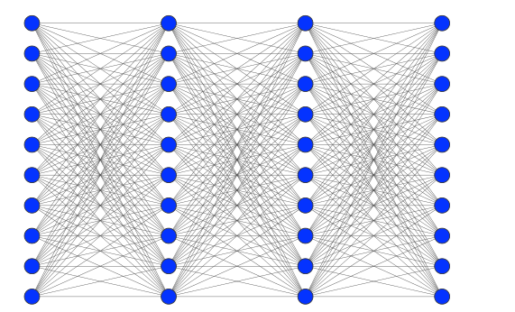
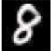
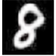

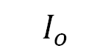
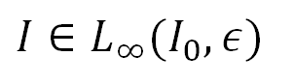
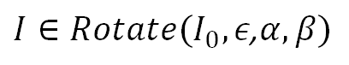
Adversarial regions
Neural network f
8
$$I_{o}$$
Neural network f
7
$I∈L_{∞}(I_{0},ε)$
Neural network f
9
$${I∈Rotate(I}_{0},ε\text{,}α,β)$$

Slide 7
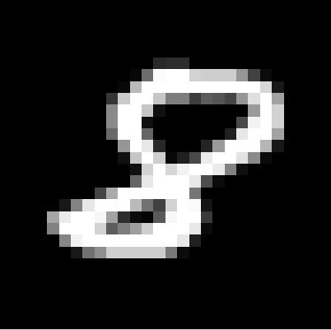
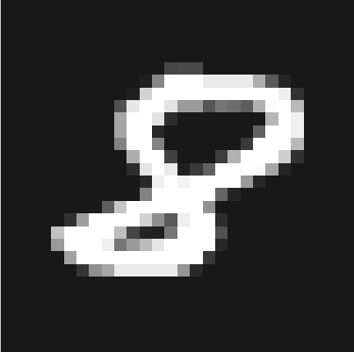







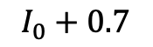

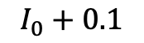
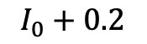
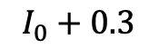
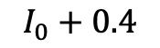
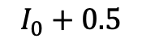
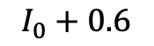
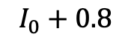

Adversarial region $L_{∞}(I_{0},ε)$
All images $I$ where the intensity at each pixel differs from the intensity at the corresponding pixel in $I_{0}$ by $≤ε$
$$I_{0}$$
$$I_{0}+0.1$$
$$I_{0}+0.2$$
$$I_{0}+0.3$$
$$I_{0}+0.4$$
$$I_{0}+0.5$$
$$I_{0}+0.6$$
$$I_{0}+0.7$$
$$I_{0}+0.8$$

Slide 8
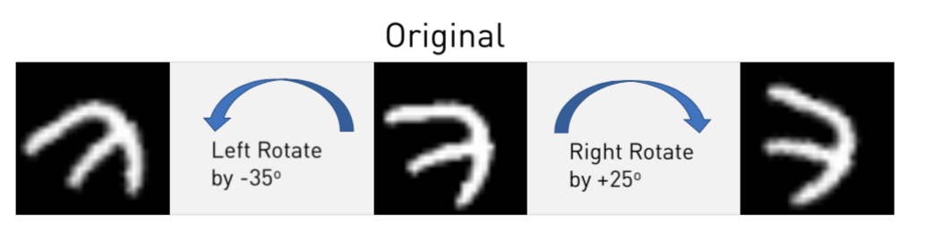

Adversarial region ${Rotate(I}_{0},ε\text{,}α,β)$
All images $I$ which are obtained by rotation each image in $L_{∞}\left(I_{0},ε\right)$ by an angle between $α$ and $β$ using bilinear interpolation

Slide 9


Adversarial region
ERAN analyzer
https://github.com/eth-sri/eran
Intensity changes
Box
Geometric transformations
DeepZ
DeepPoly
Yes
Noise+Audio preprocessing
RefineZono
K-Poly
No
Aircraft
sensors
Possible sensor values
Based on ELINA
https://github.com/eth-sri/ELINA
Tensorflow graph as input
Neural Network
Sound with respect to floating
point arithmetic
Fully connected
Convolutional
Residual
LSTM
ReLU
Sigmoid
Tanh
Maxpool
Both complete and incomplete
verification
State-of-the-art precision and
performance
Safety Property
Used by

Slide 10
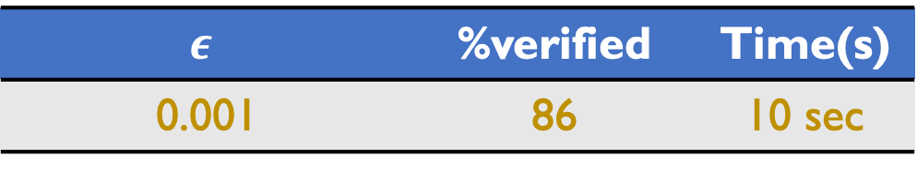
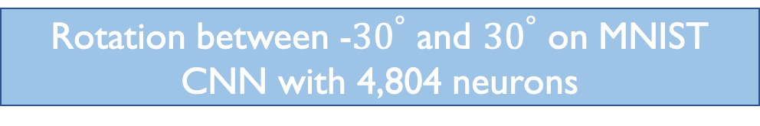
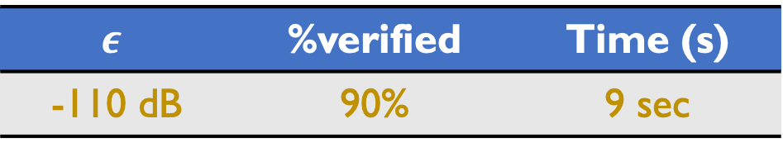
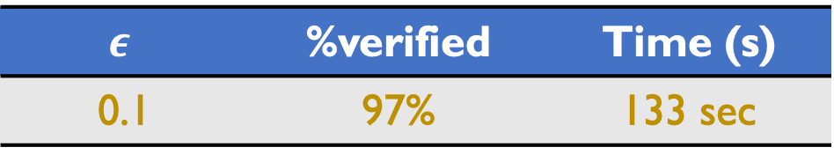
Results with ERAN
Aircraft collision avoidance system
MNIST CNN with > 88K neurons
Reluplex | Neurify | ERAN
> 32 hours | 921 sec | 227 sec
$$ε$$ | %verified | Time (s)
0.1 | 97% | 133 sec
Rotation between -${30}^{°}$ and ${30}^{°}$ on MNIST CNN with 4,804 neurons
LSTM with 64 hidden neurons
$$ε$$ | %verified | Time(s)
0.001 | 86 | 10 sec
$$ε$$ | %verified | Time (s)
-110 dB | 90% | 9 sec
10

Slide 11
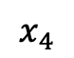
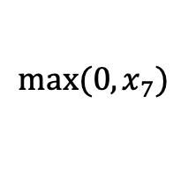
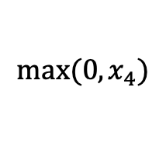
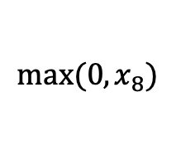
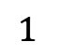
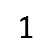
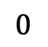
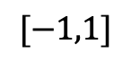
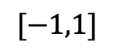
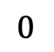

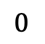

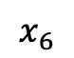
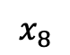
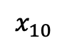
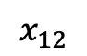













Example: Analysis of a Toy Neural Network
Input layer
Hidden layers
Output layer
$$0$$
$$0$$
$$1$$
$$[−1,1]$$
$$1$$
$$max⁡(0,x_{3})$$
$$1$$
$$max⁡(0,x_{7})$$
$$1$$
$$x_{1}$$
$$x_{3}$$
$$x_{5}$$
$$x_{7}$$
$$x_{9}$$
$$x_{11}$$
$$1$$
$$1$$
$$0$$
$$1$$
$$1$$
$$1$$
$$x_{2}$$
$$x_{4}$$
$$x_{6}$$
$$x_{8}$$
$$x_{10}$$
$$x_{12}$$
$$[−1,1]$$
$$−1$$
$$max⁡(0,x_{4})$$
$$−1$$
$$max⁡(0,x_{8})$$
$$1$$
$$0$$
$$0$$
$$0$$
We want to prove that $x_{11}>x_{12}$ for all values of $x_{1},x_{2}$ in the input set

Slide 12






Input layer
Hidden layers
Output layer
$$0$$
$$0$$
$$1$$
$$[−1,1]$$
$$1$$
$$max⁡(0,x_{3})$$
$$1$$
$$max⁡(0,x_{7})$$
$$1$$
$$x_{1}$$
$$x_{3}$$
$$x_{5}$$
$$x_{7}$$
$$x_{9}$$
$$x_{11}$$
$$1$$
$$1$$
$$0$$
$$1$$
$$1$$
$$1$$
$$x_{2}$$
$$x_{4}$$
$$x_{6}$$
$$x_{8}$$
$$x_{10}$$
$$x_{12}$$
$$[−1,1]$$
$$−1$$
$$max⁡(0,x_{4})$$
$$−1$$
$$max⁡(0,x_{8})$$
$$1$$
$$0$$
$$0$$
$$0$$
Each $x_{j}=max(0,x_{i})$ corresponds to
($x_{i}≤0$ and $x_{j}=0$) or
($x_{i}>0$ and $x_{j}=x_{i}$)
Solver has to explore two paths per ReLU
resulting in exponential number of paths
Complete verification with solvers often does not scale

Slide 13


Abstract Interpretation
An elegant framework for approximating concrete behaviors
Key Concept: Abstract Domain
Abstract element: approximates set of concrete points
Concretization function $γ$: concretizes an abstract element to the set of points that it represents.
Abstract transformers: approximate the effect of applying concrete transformers e.g. affine, ReLU
Patrick Cousot
Inventor
Tradeoff between the precision and the scalability of an abstract domain

Slide 14
Analysis Trade-offs: Precision vs. Scalability
Publication | Description
AI²: Safety and Robustness Certification of Neural Networks with Abstract Interpretation, Oakland Security & Privacy, 2018 (Gehr, Mirman, Drachsler-Cohen, Tsankov, Chaudhuri, Vechev) | AI2: Generic conceptual framework for analyzing neural networks with AI.
Fast and Effective Robustness Certification NeurIPS 2018 (with Gehr, Mirman, Vechev, Püschel) | DeepZ: Zonotope domain with new custom abstract transformers tailored to neural networks
An Abstract Domain for Certifying Neural Networks POPL 2019 (with Gehr, Vechev, Püschel) | DeepPoly: New, restricted polyhedra domain with abstract transformers specifically tailored to neural networks
Boosting Robustness Certification of Neural Networks ICLR 2019 (with Gehr, Vechev, Püschel) | RefineZono: Best of both: AI + solvers. More scalable than pure MILP solutions and more precise than pure AI (but less scalable)
More scalable
Less precise
More scalable
Less precise
More precise
Less scalable

Slide 15


































Box Abstract Domain
$$[−1,1]$$
$$[−2,2]$$
$$[0,2]$$
$$[0,4]$$
$$[0,4]$$
$$[1,7]$$
$$0$$
$$0$$
$$1$$
$$[−1,1]$$
$$1$$
$$max⁡(0,x_{3})$$
$$1$$
$$max⁡(0,x_{7})$$
$$1$$
$$x_{1}$$
$$x_{3}$$
$$x_{5}$$
$$x_{7}$$
$$x_{9}$$
$$x_{11}$$
$$1$$
$$1$$
$$0$$
$$1$$
$$1$$
$$1$$
$$x_{2}$$
$$x_{4}$$
$$x_{6}$$
$$x_{8}$$
$$x_{10}$$
$$x_{12}$$
$$[−1,1]$$
$$−1$$
$$max⁡(0,x_{4})$$
$$−1$$
$$max⁡(0,x_{8})$$
$$1$$
$$0$$
$$0$$
$$0$$
$$[−1,1]$$
$$[−2,2]$$
$$[0,2]$$
$$[−2,2]$$
$$[0,2]$$
$$[0,2]$$
Verification with the Box domain fails as it cannot capture relational information

Slide 16


DeepPoly Abstract Domain [POPL’19]
Shape: associate a lower polyhedral $a_{i}^{≤}$and an upper polyhedral $a_{i}^{≥}$ constraint with each $x_{i}$
Concretization of abstract element $a:$
Domain invariant: store auxiliary concrete lower and upper bounds $l_{i}$, $u_{i}$ for each $x_{i}$
less precise than Polyhedra, restriction needed to ensure scalability
captures affine transformation precisely unlike Octagon, TVPI
custom transformers for ReLU, sigmoid, tanh, and maxpool activations
$n:$ #neurons, $m:\#$constraints
$w_{max}:$ max #neurons in a layer, $L$: # layers
Transformer | Polyhedra | Our domain
Affine | $$Ο(nm^{2})$$ | $$Ο(w_{max}^{2}L)$$
ReLU | $$Ο(exp⁡(n,m))$$ | $$Ο(1)$$

Slide 17




Example: Analysis of a Toy Neural Network
Input layer
Hidden layers
Output layer
$$0$$
$$0$$
$$1$$
$$[−1,1]$$
$$1$$
$$max⁡(0,x_{3})$$
$$1$$
$$max⁡(0,x_{7})$$
$$1$$
$$x_{1}$$
$$x_{3}$$
$$x_{5}$$
$$x_{7}$$
$$x_{9}$$
$$x_{11}$$
$$1$$
$$1$$
$$0$$
$$1$$
$$1$$
$$1$$
$$x_{2}$$
$$x_{4}$$
$$x_{6}$$
$$x_{8}$$
$$x_{10}$$
$$x_{12}$$
$$[−1,1]$$
$$−1$$
$$max⁡(0,x_{4})$$
$$−1$$
$$max⁡(0,x_{8})$$
$$1$$
$$0$$
$$0$$
$$0$$
1. 4 constraints per neuron 2. Pointwise transformers => parallelizable. 3. Backsubstitution => helps precision. 4. Non-linear activations => approximate and minimize the area

Slide 18





$$0$$
$$0$$
$$1$$
$$[−1,1]$$
$$1$$
$$max⁡(0,x_{3})$$
$$1$$
$$max⁡(0,x_{7})$$
$$1$$
$$x_{1}$$
$$x_{3}$$
$$x_{5}$$
$$x_{7}$$
$$x_{9}$$
$$x_{11}$$
$$1$$
$$1$$
$$0$$
$$1$$
$$1$$
$$1$$
$$x_{2}$$
$$x_{4}$$
$$x_{6}$$
$$x_{8}$$
$$x_{10}$$
$$x_{12}$$
$$[−1,1]$$
$$−1$$
$$max⁡(0,x_{4})$$
$$−1$$
$$max⁡(0,x_{8})$$
$$1$$
$$0$$
$$0$$
$$0$$

Slide 19












ReLU activation
Pointwise transformer for $x_{j}≔max(0,x_{i})$ that uses $l_{i},u_{i}$
$$if u_{i}≤0, a_{j}^{≤}=a_{j}^{≥}=0,l_{j}=u_{j}=0,$$
$$if l_{i}≥0, a_{j}^{≤}=a_{j}^{≥}=x_{i},l_{j}=l_{i},u_{j}=u_{i},$$
$$if l_{i}<0 and u_{i}>0$$
$$max⁡(0,x_{3})$$
$$x_{3}$$
$$x_{5}$$
$$x_{4}$$
$$x_{6}$$
$$max⁡(0,x_{4})$$
choose (b) or (c) depending on the area
Constant runtime

Slide 20






Affine transformation after ReLU
$$x_{5}$$
$$1$$
$$0$$
$$x_{7}$$
$$x_{6}$$
$$1$$
Imprecise upper bound${ u}_{7}$ by substituting $u_{5},u_{6}$ for $x_{5}$ and $x_{6}$ in $a_{7}^{≥}$

Slide 21

Backsubstitution
$$x_{5}$$
$$1$$
$$0$$
$$x_{7}$$
$$x_{6}$$
$$1$$

Slide 22







$$0$$
$$1$$
$$max⁡(0,x_{3})$$
$$x_{1}$$
$$x_{3}$$
$$x_{5}$$
$$1$$
$$1$$
$$0$$
$$x_{7}$$
$$1$$
$$x_{4}$$
$$x_{6}$$
$$1$$
$$x_{2}$$
$$−1$$
$$max⁡(0,x_{4})$$
$$0$$
Affine transformation with backsubstitution is pointwise, complexity: $Ο\left(w_{max}^{2}L\right)$

Slide 23






$$0$$
$$0$$
$$1$$
$$[−1,1]$$
$$1$$
$$max⁡(0,x_{3})$$
$$1$$
$$max⁡(0,x_{7})$$
$$1$$
$$x_{1}$$
$$x_{3}$$
$$x_{5}$$
$$x_{7}$$
$$x_{9}$$
$$x_{11}$$
$$1$$
$$1$$
$$0$$
$$1$$
$$1$$
$$1$$
$$x_{2}$$
$$x_{4}$$
$$x_{6}$$
$$x_{8}$$
$$x_{10}$$
$$x_{12}$$
$$[−1,1]$$
$$−1$$
$$max⁡(0,x_{4})$$
$$−1$$
$$max⁡(0,x_{8})$$
$$1$$
$$0$$
$$0$$
$$0$$

Slide 24

Checking for robustness
Prove $x_{11}−x_{12}>0$for all inputs in $\left[−1,1\right]×[−1,1]$
Computing lower bound for $x_{11}−x_{12}$ using $l_{11}, u_{12}$ gives -$1$ which is an imprecise result
With backsubstitution, one gets $1$ as the lower bound for $x_{11}−x_{12}$, proving robustness

Slide 25

Benchmarks
Dataset | Model | Type | #Neurons | #Layers | Defense
MNIST | 6 $×$100 | feedforward | 610 | 6 | None
 | 6 $× 2$00 | feedforward | 1,210 | 6 | None
 | 9 $× 2$00 | feedforward | 1,810 | 9 | None
 | ConvSmall | convolutional | 3,604 | 3 | DiffAI
 | ConvBig | convolutional | 34,688 | 6 | DiffAI
 | ConvSuper | convolutional | 88,500 | 6 | DiffAI
CIFAR10 | ConvSmall | convolutional | 4,852 | 3 | DiffAI

Slide 26

Results
Dataset | Model | $$ε$$ | DeepZ |  | DeepPoly |  | RefineZono
 |  |  | $$\text{\% }\text{✅}$$ | time(s) | %✅ | time(s) | %✅ | time(s)
MNIST | 6 $×$100 | 0.02 | 31 | 0.6 | 47 | 0.2 | 67 | 194
 | 6 $×$200 | 0.015 | 13 | 1.8 | 32 | 0.5 | 39 | 567
 | 9 $×$200 | 0.015 | 12 | 3.7 | 30 | 0.9 | 38 | 826
 | ConvSmall | 0.12 | 7 | 1.4 | 13 | 6.0 | 21 | 748
 | ConvBig | 0.2 | 79 | 7 | 78 | 61 | 80 | 193
 | ConvSuper | 0.1 | 97 | 133 | 97 | 400 | 97 | 665
CIFAR10 | ConvSmall | 0.03 | 17 | 5.8 | 21 | 20 | 21 | 550

Slide 27
Future work
Specifications | Robustness over a distribution, Image segmentation
Networks | Reinforcement learning, GANs, Recurrent, Regression, Capsule, Networks + Controllers
Precise and scalable verification | Scaling to larger networks while being precise, e.g., resnet34 for Imagenet, Tailored solver for neural networks
Training | Train networks to be more provable, Proof transfer

Slide 28



Conclusion
Aircraft collision avoidance system
Reluplex | Neurify | ERAN
> 32 hours | 921 sec | 227 sec

Slide 29







Abstract Interpretation + Solvers
Key Idea: refine abstract interpretation results by calling the solver
Refine neuron bounds before ReLU transformer is applied $=>$ less area
$$x_{10}$$
$$x_{8}$$
$$l_{8}$$
$$l_{8}^{′}$$
$$u_{8}^{′}$$
$$u_{8}$$

Slide 30




Neural network robustness
Challenges
Neural network $f:ℝ^{m}⟶ℝ^{n}$
Adversarial region $ℛ\left(I_{0},φ\right)$
The size of $ℛ\left(I_{0},φ\right)$ grows exponentially in the number of pixels:
cannot compute f$\left(I\right)$ for all $I$ separately
Given:
$L_{∞}\left(I_{0},ε\right):$ All images $I$ where pixel values in $I$and $I_{0}$ differ by at most $ε$
Rotate($I_{0},ε$,$α,β$): All images $I$ in $L_{∞}\left(I_{0},ε\right)$ rotated by $θ∈[α,β]$
Related work on certification
Adversarial
Regions:
Precise but does not scale:
SMT solving [CAV’17]
input refinement [USENIX’18]
semidefinite relaxations [ICLR’18]
Scales but imprecise
linear relaxations [ICML’18]
duality [UAI’18]
$∀I∈ℛ\left(I_{0},φ\right).f\left(I\right)[c]>f(I)[j]$ where c is the correct output and j is any other output
To Prove:

Slide 31

Using AI to Train Robust Deep Learning
Idea: define abstract loss to include AI result, apply automatic differentiation on AI
Training Method | Accuracy % | Certified %
Baseline | 98.4 | 2.8
Madry et al. | 98.8 | 11.2
DiffAI (our method) | 99.0 | 96.4
Convolutional Network with 124,000 neurons, L$∞$with $ϵ=0.1$
Differentiable Abstract Interpretation for Provably Robust Neural Networks
ICML 2018
(Matthew Mirman, Timon Gehr, Martin Vechev)

Slide 32
Released Frameworks
Framework for verification of deep neural networks, supports various numerical domains, floating-point sound, different perturbations, largest dataset to date: 50+ networks. Currently the most scalable and precise verifier.
http://github.com/eth-sri/eran
Framework for training deep neural nets to be more robust using symbolic analysis. Different defenses and attacks (PGD, PGD + DiffAI). Currently the most scalable framework.
http://github.com/eth-sri/diffai

Slide 33


Challenges and Open Problems
Typically, some norm: L$0\text{,} \text{L}1\text{,} \text{L}∞$
How about geometric changes? Distributions?
 guarantees: unbounded number of images?
Specification
What is a good abstraction?
How do we leverage testing results?
How to battle approximation loss downstream?
Creative combinations with complete methods?
Verification
Classification? Reinforcement Learning?
Regression? Recurrent?
Combinations of models?
Networks
Accuracy vs. Robustness?
Provability vs. Accuracy?
Trade-offs

Slide 34





Examples of adversarial regions
8
$$I_{o}$$
The neural network classifies the image $I_{o}$ correctly as 8
0
$${I=I}_{o}+0.01$$
When $ϵ=0.01$ is added to the intensity of each pixel in $I_{o}$, the network misclassifies the perturbed image $I$as 0 even though $I$ appears as 8 to the human eye
$L_{∞}$-norm: consider all images $I$ in the $ε$-ball$ℬ_{(I_{0},∞)}(ε)$ around $I_{0}$

Slide 35




Examples of adversarial regions
7
$$I_{o}$$
The neural network classifies the image $I_{o}$ correctly as 7
3
${I=rotate(I}_{o}$,-$35)$
When $I_{o}$ is left rotated by -$35^{°}$, the network misclassifies the perturbed image $I$as 3 even though $I$ appears as 7 to the human eye
Consider all images $I$ obtained by applying geometric transformations to$ℬ_{(I_{0},∞)}(ε)$

